Slide 1


Exercise Western Dawn 2025
Pitch Presentation: Team 4
Notes:
All out front:

Slide 2
Team Introduction
Innovation Theme: Persistent Situational Awareness: Enhanced capacity in close proximity to critical infrastructure
Team Leader: Sam Tennent – 13th Engineer Regiment
Team Facilitator: Chris Gallen – HQ 13th Brigade
Team Members: Ross Sandrock - Systems Accord David Veerman – Camco Engineering
Adam Bennett – Red Pirahna Ray Endrasmoro - Curtin University M're Capangpangan – Curtin University
!
Notes:
Good morning everyone, my name is Chris Gallen, the team facilitator for team 4
Our Innovation Theme was Persistent Situational Awareness and enhanced capacity in close proximity to critical infrastructure
Our team comprises two Army members : Sam and myself. Three from Industry : Ross, David and Adam and Two from Curtin uni: Ray and M’re.

Slide 3
Software Defined
Machine Learning
Radar
Notes:
Our proposal is a mass produced, affordable, lightweight, and easily deployable Software Defined Machine Learning Radar that provides Persistent Situational Awareness in close proximity to remote critical infrastructure.
It uses the Radio Frequency spectrum, passively or actively, to detect and identify threats which are then reported to the local user.

Slide 4
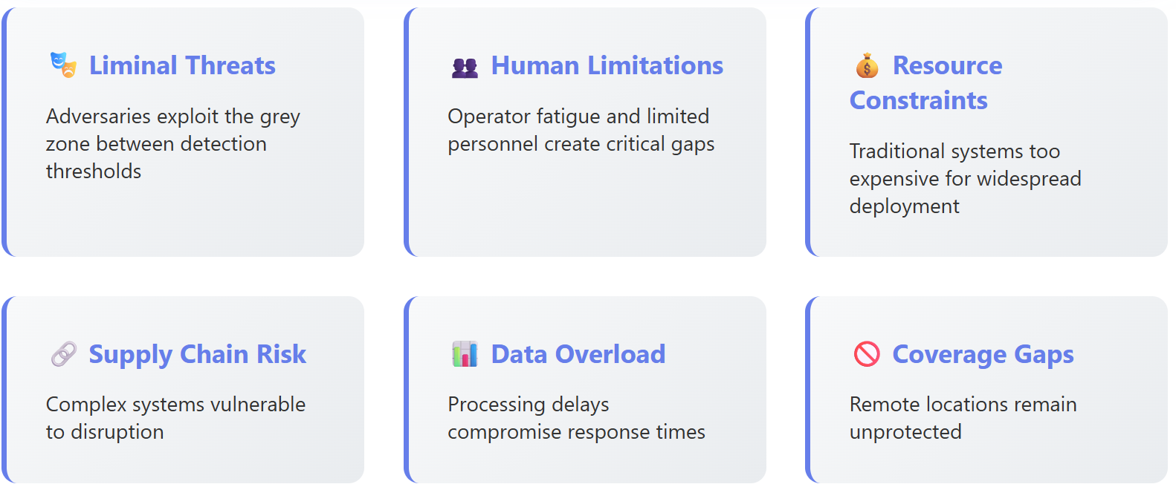
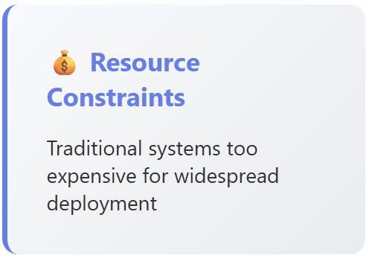
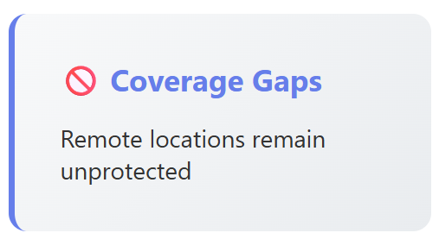
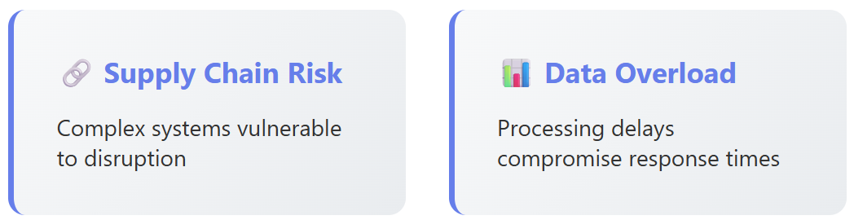
Problem
Challenges to Protecting Remote Critical Infrastructure
!
Notes:
So what's the problem? Critical infrastructure assets in remote areas are vulnerable to multi-domain liminal threats. (that is, being compromised from many directions, in times prior to conflict)
The nature, size and location of these remote assets limits the options for physical protection.
Maintaining persistent situational awareness using personnel on the ground is not always an efficient use of a limited resource and may not be desirable during peacetime.
Current detection systems are generally expensive with long lead times and not easily or quickly relocated to these remote locations.
Large volumes of data generated from multi-spectral sensors can obscure useful intelligence without efficient processing at the point of collection.
Supply chains, particularly those that rely on international sources, can be easily interrupted.
Our question is : How can an Australian team deliver a scalable, flexible, rapidly deployable solution to providing persistent situational awareness in close proximity to remote critical infrastructure?

Slide 5
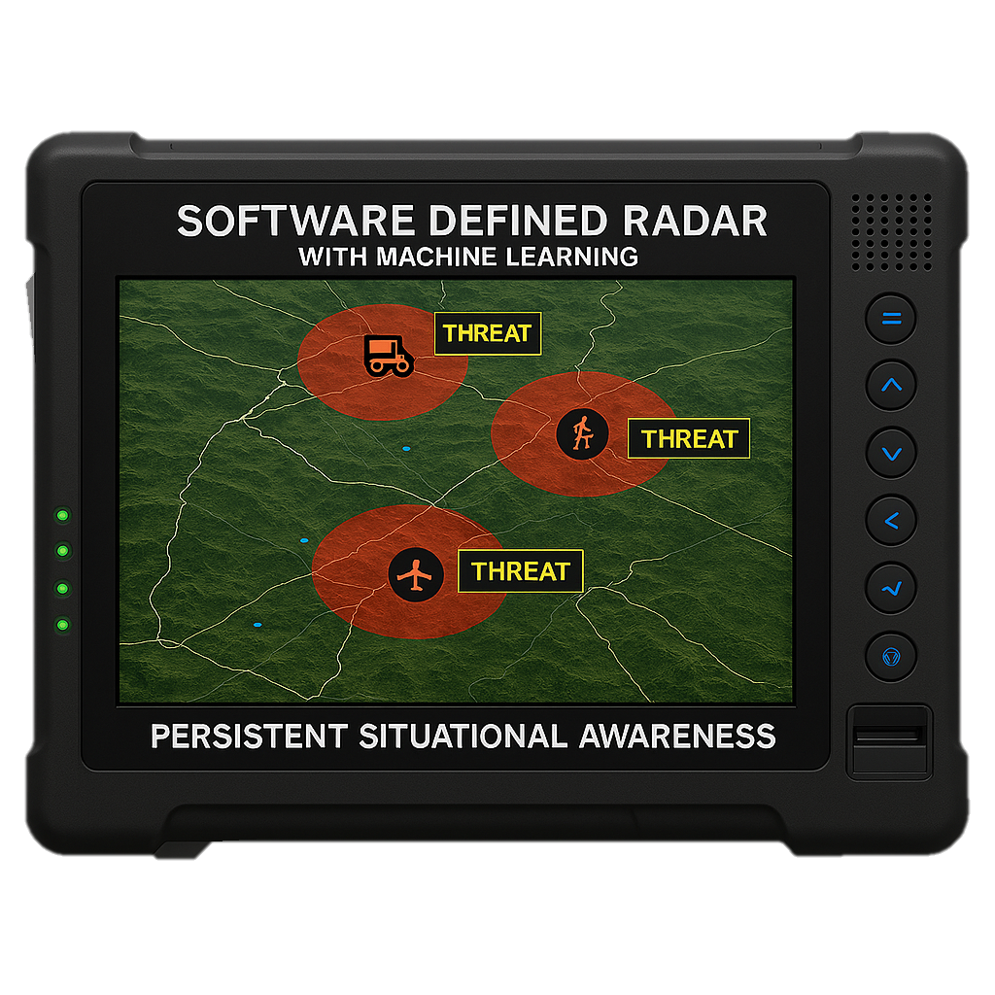

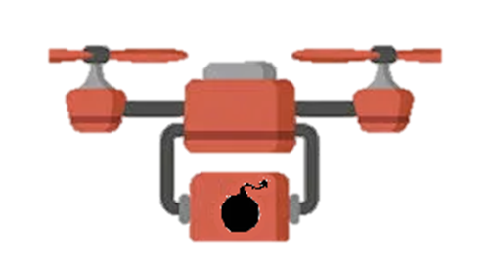



Capability Concept
SMR : Software Defined, Machine Learning, Radar
A Deployable Passive & Active RADAR using Digital RF & Machine Learning
End User
Brigade asset
Deployment
Affordable, scalable, portable, disposable
Situational Awareness
Real-time with map overlays
Integration
ADF C2 systems and GIS platforms
!
Notes:
SMR is a Software Defined, Machine Learning, Radar
SMR is a smart radar system made up of small sensor nodes spread across remote terrain.
Each node sees and responds to changes in the radio environment, working together to build a clear picture of what’s happening.
It shows us the invisible, the energy bouncing off and powering modern technology, giving frontline soldiers a new kind of awareness.
Where cameras and LiDAR need a clear view, this capability sees modern invisible threats beyond visual range. It’s a superpower in the field.
It’s built to be low-cost, unmanned and hard to detect; sensing quietly, without giving away its position.
And it’s flexible. Nodes can be reprogrammed from afar, shifting instantly to match the changing battlefield.
This is secure, affordable, multi-sensor intelligence at the edge

Slide 6
Scenario Example
Remote critical infrastructure
Configured response to anticipated threat
Passively and actively monitoring
Threat detected
Alerts Operations Centre
Threat identified
Automatic reconfiguration to EA counterattack
!
Notes:
Consider this scenario, [NEXT] a remote asset acts as a major electrical interconnect to critical strategic assets further down the grid. Proactively, SMR nodes are placed in a perimeter around the asset.
[NEXT]
Several nodes are configured to passively monitor the RF environment, characterizing what normal looks like and monitoring for significant changes and anomalies.
The remainder of the nodes are configured to use the internode-communication transmissions as RADAR pings, measuring reflections from local airborne objects.
The system is configured with pre-planned responses to anticipated threats.
Each node is powered by solar and ruggedized for the local environment, the system sits active and reporting back to the Command for months.
As a lead up action to a larger strategic event, [NEXT] hostile UAVs are sent to disrupt the asset.
The SMR system detects the incursion to the airspace several kilometers out from the asset.
The Machine Learning identifies the threat and based on the pre-programmed threat response, the nodes cooperatively re-configure to electronic attack, [NEXT] attempting to disrupt and block the GPS and command and control link used by the threat.
[NEXT]
With GPS and Coms lost, the UAVs are ineffective in their preemptive strike on the critical infrastructure.
Consider this Scenario: SMR : SDR ML RADAR is a Remote Infrastructure Defense
A remote substation powers critical assets across the grid.
Six SMR nodes form a 1-kilometer perimeter around it.
Three nodes passively monitor radio frequencies—learning what “normal” looks like and spotting anomalies.
Three others use internode pings as radar, detecting airborne objects.
Each node is solar-powered, rugged, and reports back for months without maintenance.
Before a major strategic event, hostile UAVs approach—armed with explosives.
The system detects them kilometers out and identifies the threat.
Instantly, three nodes jam GPS signals.
The other three block the UAVs’ command-and-control links.
With navigation and communications disabled, the UAVs fail.
The substation stays online. The mission is protected.

Slide 7
SMR : A Paradigm Shift in Detection
X
Traditional RADAR
✓
SMR Innovation
X
Millions per unit
✓
$ per unit
X
Heavy and Obtrusive
✓
Portable and discreet
X
High Power Consumption
✓
Low Power operation
X
Fixed Capabilities
✓
Software adaptable
X
Complex Maintenance
✓
Self healing mesh
X
Single point of failure
✓
Passive Monitoring
Notes:
Now let’s talk about why SMR is not just an improvement—but a complete paradigm shift in detection.
Traditional defence radars are rare, expensive, and mission‑critical — think of Australia’s JORN network or NATO’s long‑range air defence radars. They cost millions, need specialist crews, and must be protected at all times.
[Hold up USB SDR and antenna]
This is different. This is digital RF — a software‑defined radio that can be a radar, a VHF receiver, a TV decoder, or a wideband transceiver. One device, many roles — replacing what used to be rare, expensive and single purpose dedicated hardware.
Old systems were locked into whatever they were built to do. Here, the signal becomes data, and software does the rest.
Traditional radar systems are effective, but they come with enormous costs—financially, logistically, and operationally. They’re large, heavy, and consume significant power. Their capabilities are fixed, which limits their ability to adapt as threats evolve. They require complex maintenance and, too often, become a single point of failure—if one system goes down, critical coverage is lost.
SMR takes a different path. It is lightweight, portable, and designed for low-power operation, making it suitable for deployment in environments where traditional systems simply aren’t viable. Because it’s software-defined, SMR can be continuously updated to meet emerging challenges.
And unlike centralised systems, SMR operates as a self-healing mesh, so even if one node is compromised, the network automatically reconfigures itself. That ensures resilience and persistence across the battlespace or critical infrastructure sites.
In short, SMR doesn’t just improve on traditional radar—it redefines surveillance: affordable, adaptable, and resilient for the future of defence and security.

Slide 8
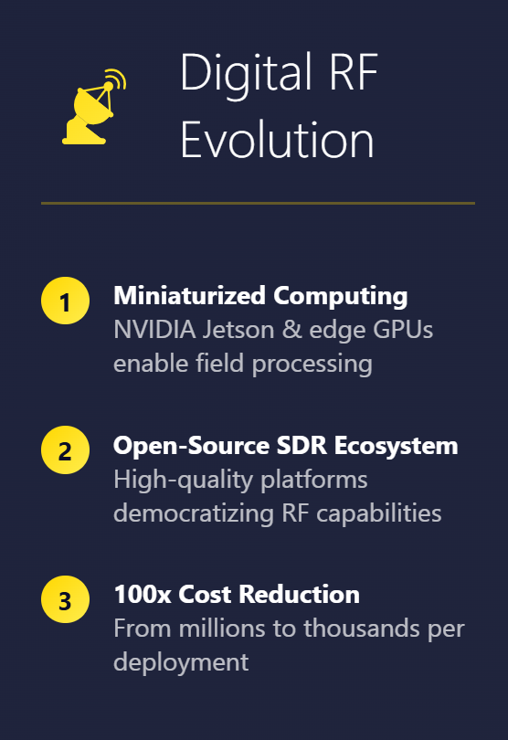
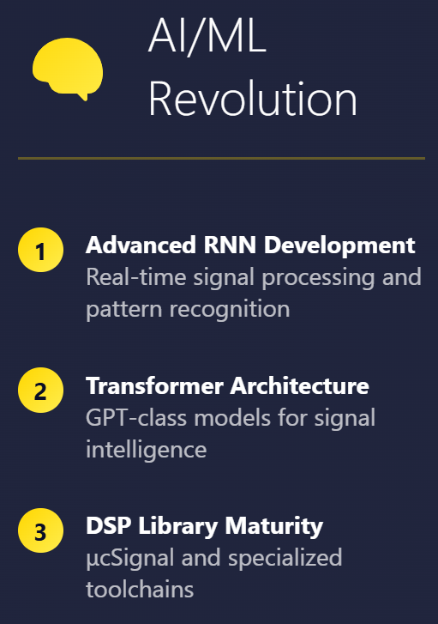
Collaboration Opportunity : Industry, Defence and Academic
Digital RF
+ Software +
Machine Learning
The Opportunity
Software-Defined Future
Affordable & Scalable: Deploy hundreds at fraction of the cost
✓Multi-Role Capable: One device, infinite possibilities through software
✓Low Risk: Self-wipe capability, expendable by design
✓Field Upgradeable: Adapt to new missions without new hardware
Notes:
There is a Collaboration Opportunity when Industry brings innovation. Defence provides mission focus. Academia delivers research excellence.
With a software defined radio, when you change the code, you change capability required to support the new mission .
That means it can be reconfigured, upgraded, or repurposed in the field — no new hardware, no obsolescence.
By developing the software together — industry, defence, and academia — we deliver persistent monitoring, secure infrastructure, and a strategic edge.
And while a mil‑spec radio might cost $50,000 and demand constant safeguarding, ours SMR nodes are intentionally low‑cost and low‑risk.
Commanders can deploy hundreds — and with self‑wipe, they never become a liability.

Slide 9
Technology Development
Sam to do
HARDWARE
SDR Hardware Integration
Ruggedisation
Size, Weight & Power
ADF INTEGRATION
ROLLOUT
SOFTWARE
RF Processing
Machine Learning Training
TRL MATURATION
Notes:
Realizing the SMR Vision Requires Collaboration
Transforming potential into capability through joint effort:
Industry: Lead hardware development and scalable production.
Academia: Partner with industry to advance signal processing codecs and machine learning training, both realised via software. Proofing via simulation.
Defence (ADF): Field testing and provide sensor samples and also drive integration and ensure alignment with operator requirements.
Together, these domains unlock sovereign capability through innovation, adaptability, and mission focus.
SMR has multiple technology paths that need maturing.
There are three, largely independent development streams,
Hardware : Node hardware development (Blue),
Software : RF processing and ML training(Green) and
Integration : Most importantly ADF and operator integration (Purple) to enable decision making.
There is the opportunity to incrementally develop each of these streams independently,
- Industry partners are likely best suited to developing the hardware,
- Academic partners with industry to develop the SDR and ML software and
- Defence to drive integration to meet operator needs.

Slide 10
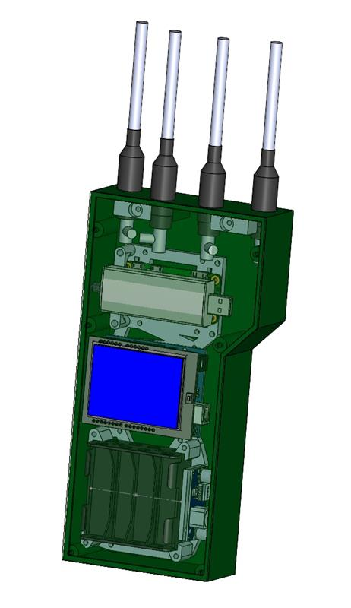
The Hardware
TRL 2 Concept
 | TRL 3 (Early Prototype - COTS) | TRL 5 (TECH DEMO) | TRL 8 (Product)
SDR Unit | 4 x Coherent SDR | In house design | Bespoke Milspec
ML Processor | Cortex-A76 rPi / PC GPU | Nvidia Jetson | TBA
Computer | Raspberry Pi / PC USB Dev | ARM A57 | TBA
Transmitter | Low Power SDR Transceiver | Power Amplifier SDR Transceiver | TBA
Housing and etc. | 3D Printed | CNC Machined | TBA
UNIT COST TOTAL | ~$1500 | TBA | 5 Km² Coverage Budget Target $35,000
!
Notes:
We’ve turned an advanced radio into a radar that thinks — small enough to carry, smart enough to change the fight. [Hold up prototype - hand to audience] This is advanced radio technology fused with machine learning — a radar that thinks.
It’s an opportunity to unite cutting‑edge digital radio, machine learning, and research expertise.
Affordable, scalable, and portable — built to go anywhere.
And if it’s ever lost, all sensitive data is gone in an instant.

Slide 11
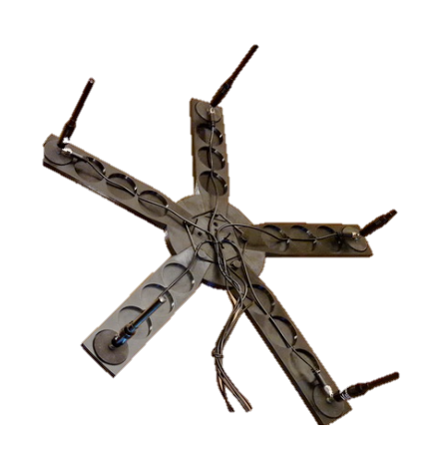
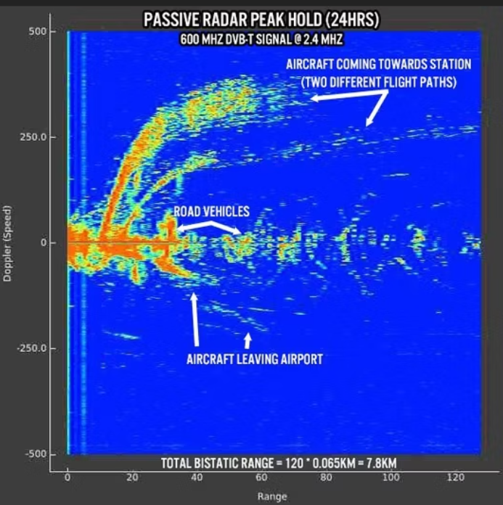
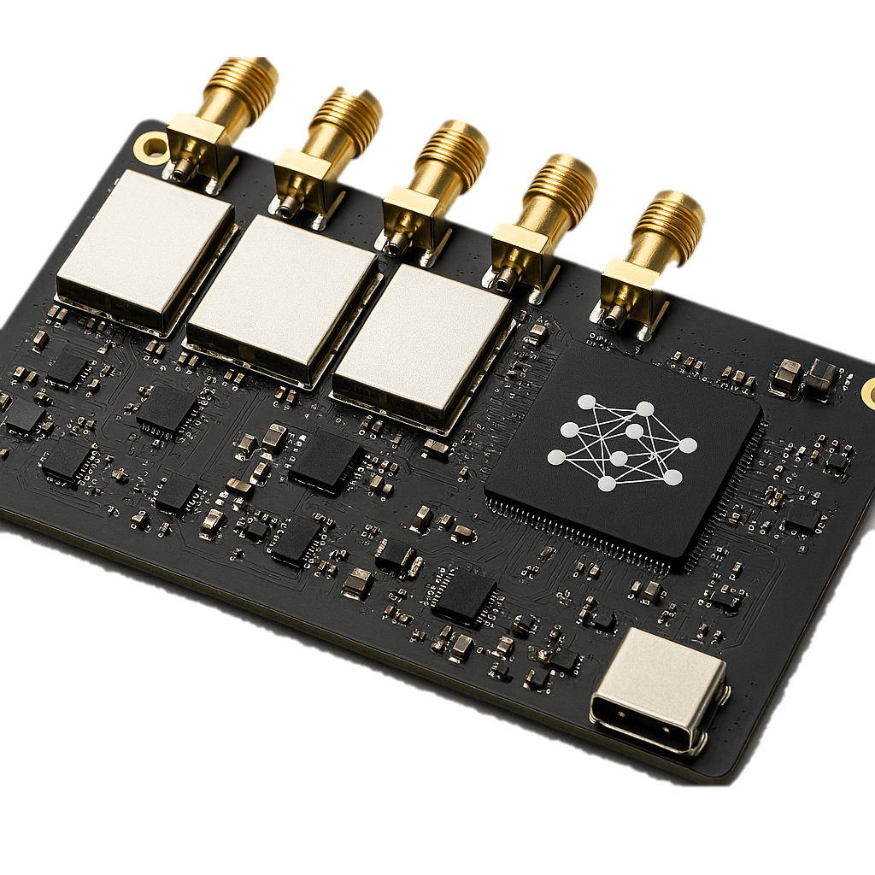
How the Node Works
RF signals
Step 1 – Listen & Convert : Digital RF Hardware
Phase‑coherent multi‑element SDR antenna array
for accurate bearing and range estimation
Digitized Waveform & Direction & Range
Step 2 – Think & Decide : Deep Learning
SDR I/Q data processing with AI/ML.
Key Feature = Unique RF Signature per device
Final Classification Neural to filter irrelevant info .
Threat Profile
Step 3 : Mesh Transmission
Transmit with only critical info to minimise duration: Threat 'ID', general type (Subject to device settings)
Int Cell
Notes:
Our radar listens to radio signals and turns them into computer data using smart software.
Then it uses Machine Learning to quickly understand the signals and make a detection classification on its own.
In the remote north‑west of Australia, the airwaves are almost silent — so any foreign signal stands out instantly.
Our device listens, learns, and classifies on its own, then sends results securely to command.
If tampered with, it wipes itself clean and warns the network — unmanned, low‑cost, and no risk if lost.

Slide 12
Inter Node Mesh & C2 link
Components of a Robust Mesh Network
C2 Link
Peer-to-Peer Links
Integration of existing backhaul techniques
Direct connections between nodes for data exchange
Robust Mesh Network
Self-Healing
Multi-Hop Routing
Automatic re-routing of traffic after node failure
Data transmission through intermediate nodes
!
Notes:
Fully integrated, each node uses an internal Mesh Networks software stack.
The inter‑node mesh network is designed so that each node can operate autonomously while still cooperating with others when possible — without relying on a single central hub or continuous high‑bandwidth connectivity.
Compliant with ADF security standards of course.
Uses proven backhaul methods to Command and Control of events and alerts without human intervention.

Slide 13
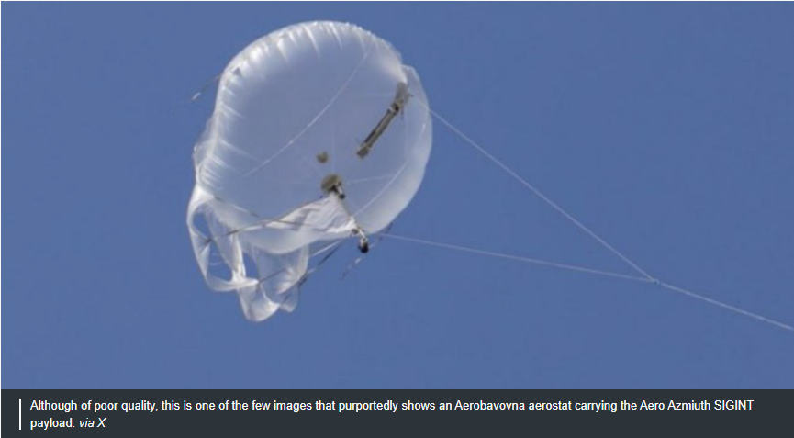
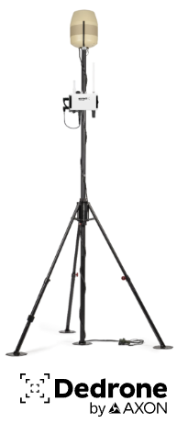
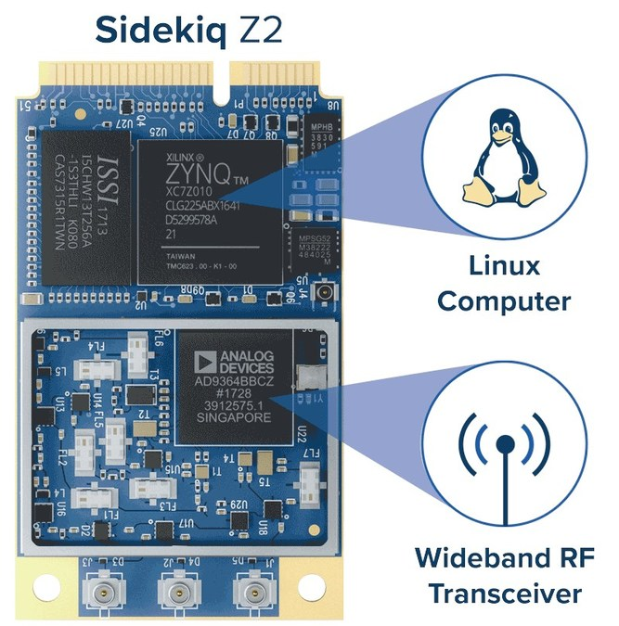
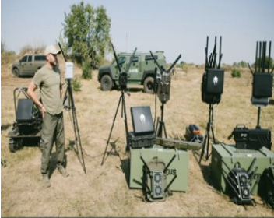
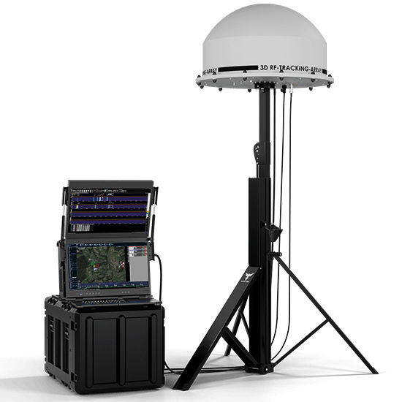
Research and Analysis – Existing
M'Re to outline 3 similar existing solutions
What's currently being used?
What technology is present?
Is there a gap in the market?
!
Notes:
Currently in use
A Counter -Unmanned Aircraft System by Kvertus (based in Ukraine) that incorporates both drone jamming and sensing capabilities that is currently being used in Ukraine
Present Technology
Dedrone by Axon (based in US) is an AI driven autonomous C2 platform that is used for C-UAS
Sidekiq Z2 by Epiq Solutions (based in US) is a wideband RF transceiver that integrates a powerful SDR and Linux computer
Gap in the market
Lacking of a product that uses the flexibility of an SDR, the scalability of a mesh network and the decision making capabilities of Machine learning
Other Existing Tech:
AARTOS by Aaronia(based in Germany) is a drone detection system that uses AI to identify threats by combining different frequency patterns
Sources:
https://www.dtccodan.com/products/sol8sdr-m
https://epiqsolutions.com/products/sdr/sidekiq-z2
https://drone-detection-system.com/sensor-types-overview/detection-rf/
https://www.airsight.com/airguard-drone-detection-software
Additional Notes:

Slide 14
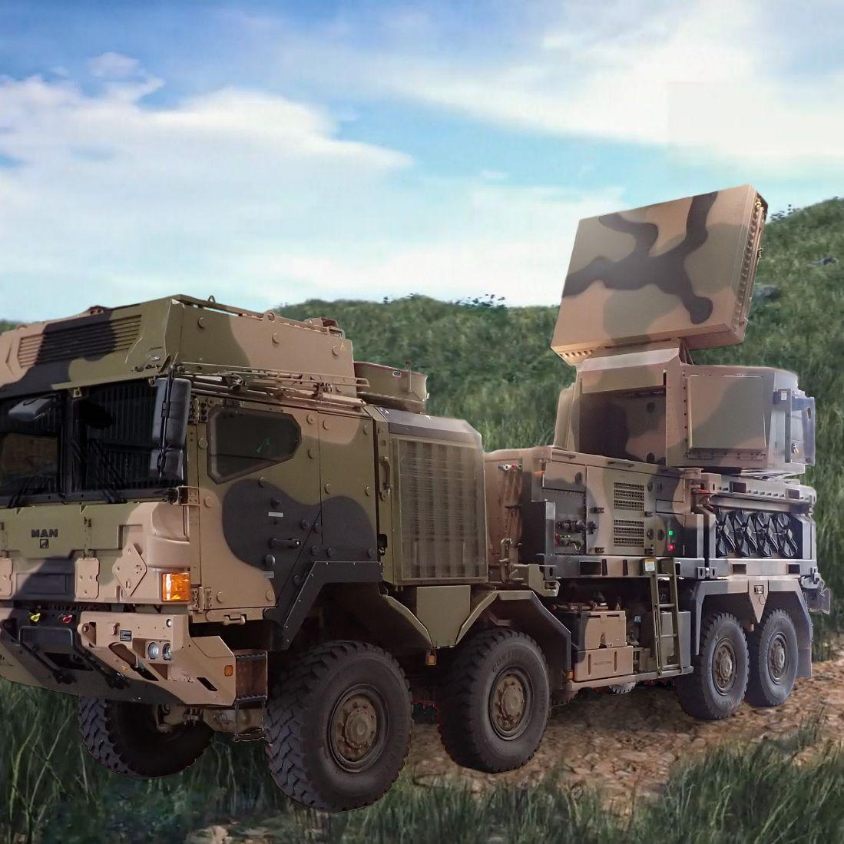
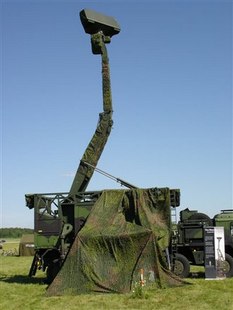
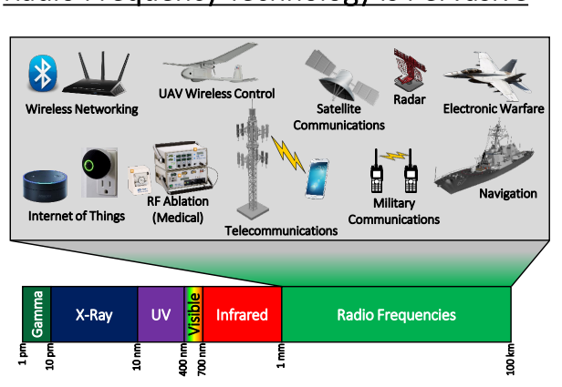
Research and Analysis - Synergies
Ray to outline 3 similar existing solutions
Deep Learning in signal processing is evolving​
and accelerating by GPU processors
SMR
Lightweight
Portable
Adaptable through software and ML
Existing RADAR
Heavy
Obtrusive
High power/fuel consumption
CEA Technologies
Giraffe AMB
AADAA
!
Notes:
Info for Giraffe AMB - https://www.saab.com/products/giraffe-amb
CEA Land RADAR (Active Electronically Scanned Arrays AESA)
Some existing RADAR technologies used in Australia, such as the ones imaged, aren’t man portable. This makes it difficult for them to exist in areas where power and fuel are inconvenient to sustain. In addition, it may be difficult to navigate around existing infrastructure or terrain in an unobtrusive manner.
SMR proposes to fill this gap through low power-consumption and being lightweight enough to be deployed by a soldier on the field, allowing RADAR to exist in areas that are hard to reach by land or sea vehicles.
Furthermore, SMR is also capable of adapting through software and machine learning, rather than hardware, making it a relatively passive system after it has been deployed."

Slide 15
Immediate Applications
✈️ Airspace Control
Black Flights (Illegal aircraft from overseas – No Id/ Radio off )
🌊 Maritime Domain
Coastal Illegal Activity detection (RF Sonar Buoy)
🔍 Search & Rescue
Civilian search and rescue (Remote & Weak signal reception)
⚡ Electronic Warfare
Early localisation of enemy counter EW efforts
!
Notes:
The same SMR — SDR ML RADAR capability can be adapted to a wide range of missions.
Here are some examples sovereign defence examples to consider;
First — coastal illegal activity detection. Think of RF‑enabled sonar buoys quietly listening offshore, picking up the tell‑tale signals of unregistered vessels before they make landfall.
Second — black flights. Aircraft coming in from overseas with no transponder, radios off. Our nodes can detect and track their emissions — or their silence — long before they cross the fence.
Third — civilian search and rescue. In remote areas, even the weakest distress beacon or handheld radio can be picked up, giving responders a fix when every minute counts.
And fourth — early localisation of enemy counter‑EW efforts. If someone starts hunting our spectrum, we know where they are and what they’re doing before they can degrade our network.
"One technology, many missions — all built on the same low‑cost, reconfigurable platform."

Slide 16
The Future of Defence is Software-Defined
Unmatched Strategic Value
🏗️
Sovereign Capability
100% Australian-developed with COTS components
🎯
Multi-Domain
Land, sea, air applications from one platform
💡
Low Barrier Entry
Unclassified COTS enables rapid manufacturing
📈
Infinite Scalability
From single node to continental coverage
🔄
Rapid Adaptation
Software updates enable new capabilities without hardware changes
🤝
Coalition Ready
Exportable technology for allied nations
Notes:
Thank you for your attention, we believe SMR presents strong strategic value.
An Australian solution for Coalition Defence.
Low barrier hardware that allows for rapid adaptation.
Multi-domain applicable that allows for infinite scalability.
Strategic Advantages
Delivering operational superiority through collaborative innovation
The Force Multiplier Effect
1 traditional system = 100+ digital RF nodes Same budget. Exponential capability. Zero obsolescence.
Persistent Coverage
Deploy hundreds of nodes for comprehensive, redundant monitoring that traditional systems can't match
Risk Mitigation
Low-cost, self-wiping units eliminate capture concerns and enable bold deployment strategies
Rapid Adaptation
Update capabilities in hours, not years. Change code to change mission parameters instantly

Slide 17

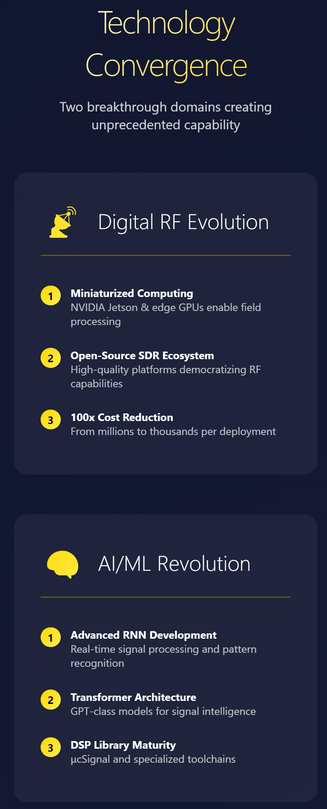

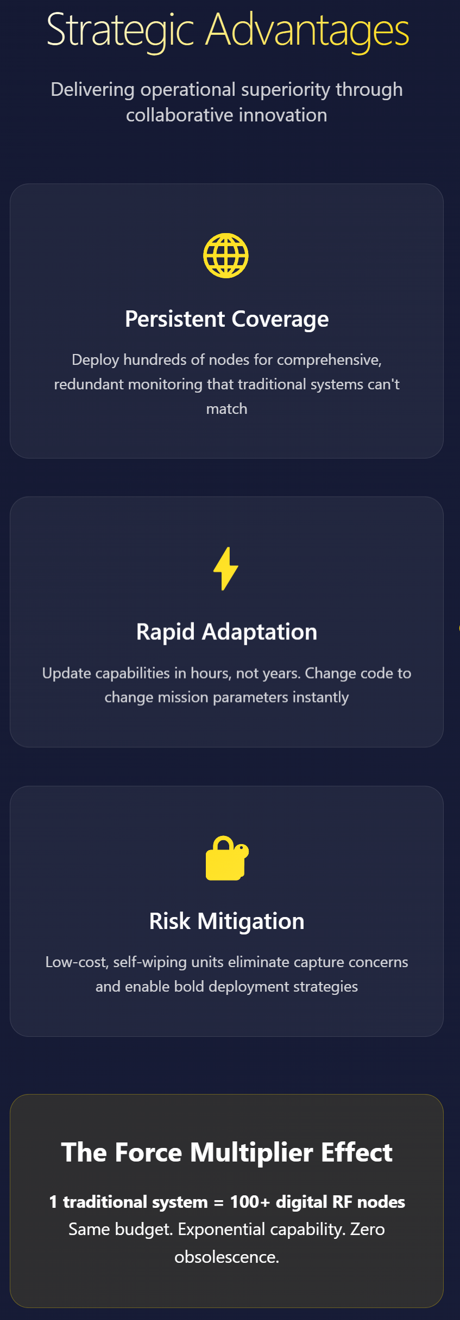



Question and Answers
SMR Hardware
Notes:
Question and Answers

Slide 18

END OF PRESENTATION

Slide 19
Scenario Example
Remote critical infrastructure
!
Remote critical infrastructure
Configured response to anticipated threat
Passively and actively monitoring
Threat detected
Alerts Operations Centre
Threat identified
Automatic reconfiguration to EA counterattack
Notes:
A remote asset acts as a major electrical interconnect to critical strategic assets further down the electrical grid. SMRs nodes are placed in a perimeter around asset.
Several nodes are configured to passively monitor the RF environment, characterizing what normal looks like and monitoring for significant changes and anomalies.
The remainder of the nodes are configured to use the internode-communication transmissions as RADAR measuring reflections from local airborne objects. The system is configured with pre-planned responses to anticipated threats.
Each node is powered by solar and ruggedized for the local environment, the system sits active and reporting back to the Security Operations Center for months.
As a lead up action to a larger strategic event, hostile UAVs are sent to disrupt the asset. The SMR system detects the incursion to the airspace several kilometers out from the asset and identifies the threat as UAVs, based on the pre-programmed threat response, the nodes cooperatively re-configure to electronic attack, attempting to disrupt and block the GPS and C2 link used by the UAVs.
With GPS and Coms lost, the UAVs are ineffective in their preemptive strike on the critical infrastructure.
Consider this Scenario: SMR : SDR ML RADAR is a Remote Infrastructure Defense
A remote substation powers critical assets across the grid.
Six SMR nodes form a 1-kilometer perimeter around it.
Three nodes passively monitor radio frequencies—learning what “normal” looks like and spotting anomalies.
Three others use internode pings as radar, detecting airborne objects.
Each node is solar-powered, rugged, and reports back for months without maintenance.
Before a major strategic event, hostile UAVs approach—armed with explosives.
The system detects them kilometers out and identifies the threat.
Instantly, three nodes jam GPS signals.
The other three block the UAVs’ command-and-control links.
With navigation and communications disabled, the UAVs fail.
The substation stays online. The mission is protected.

Slide 20
SMR Hardware

Slide 21
Tactical Considerations
Selection Transmission
Configurable setting for when reports threat via mesh. Ie
Report on threat
Report with delay
Report at an interval
Report on command
Discrete installation
Attachable to many surfaces and items.
Antenna and power supply can be attached via leads.
Man portable
Utilise existing pouchs and batteries (AN-PRC 152)
Sam to do
!

Slide 22
Rollout
Additional sensor fusion to enhance ML detection
Cooperative mutli-node retuning to focus data collection
Sovereign Defence unifying civilian SDR assets
MOVE THESE
Low barrier manufacturability – Unclass COTS items, mutlidimension supply chain
Ross to do DONE, room for expansion
!
Notes:
Thinking BlueSky, there are many potentials for this technology to extend to.
Additional sensors such as acoustics or optics can be added variables into the machine learning assessment as to whether the local environment is changing.
Rapid cooperative and coordinated retuning of multiple nodes could refine data collection similar to focusing an optical lens
With SDRs being an unclassified common radio enthusiast tool and the core technology component to the nodes, civilian SDRs could be unified and repurposed to enable sovereign defence strategies.
MOVE SOMEWHER ELSE IN PRESO
SDRs as the core technology component are now a relatively cheap commercial item with vast existing stock and diverse supply chains, allowing for resilient acquisition in a time of need

Slide 23
Flexibility, Precision, And Adaptability Across Many Signal Environments.
Q&A : Notes
Wideband Capture
Digitizing RF early allows simultaneous monitoring of multiple frequency bands (GPS, radar, comms, etc.).
Reconfigurability
A single digital receiver can switch roles (radar, comms intercept, EW detection) by loading new software IP core.
Advanced Signal Processing
Digital filtering, adaptive beamforming, pulse compression, and clutter rejection can all be done in software.
AI/ML Integration
Digitized radar returns can be directly feed into neural networks for:
Target classification
Anomaly detection
Spectrum awareness
Enables ISR systems to “learn” patterns and adapt to new threats when deployed at the edge.
Interoperability & Fusion
Digital RF enables sensor fusion (radar + EO/IR + comms intelligence) by combining multiple digitized streams in real time.
Reduced Size, Weight, and Power (SWaP)
Instead of many analog components, one flexible digital back-end processes everything.
Ideal for drones, ships, and satellites.

Slide 24
Solution
SMR : SDR ML RADAR
Distributed mesh of controllable Software Defined Radio (SDR) nodes
Low-friction alternative to traditional RADAR infrastructure
Opens RADAR capability at sub-unit level
Real-time RF monitoring
Detects changes in the radio frequency (RF) environment
Operates passively or actively
Remote Command & Control (C2) support
Each node can be independently and dynamically reconfigured based on operational needs
!
Notes:
Our proposal is SMR, a SDR Machine Learning RADAR, deployed in remote regions as a mesh network of distributed sensor nodes with intelligent edge processing.
SMR provides a low friction alternative to traditional RADAR infrastructure, capturing changes in the RF environment passively or actively in real-time.
Supported by remotely located C2 infrastructure, each SMR node can be independently dynamically reconfigured based on operational needs.

Slide 25
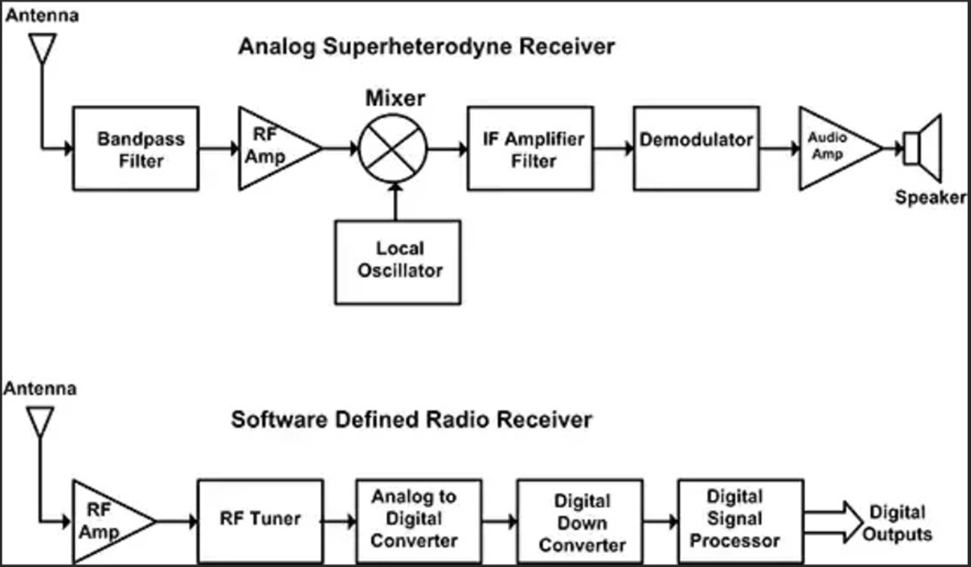
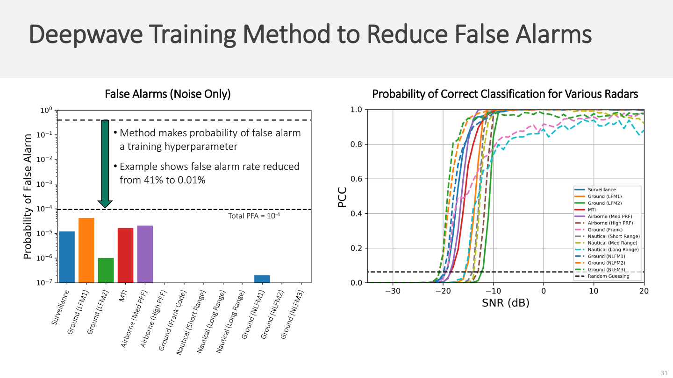
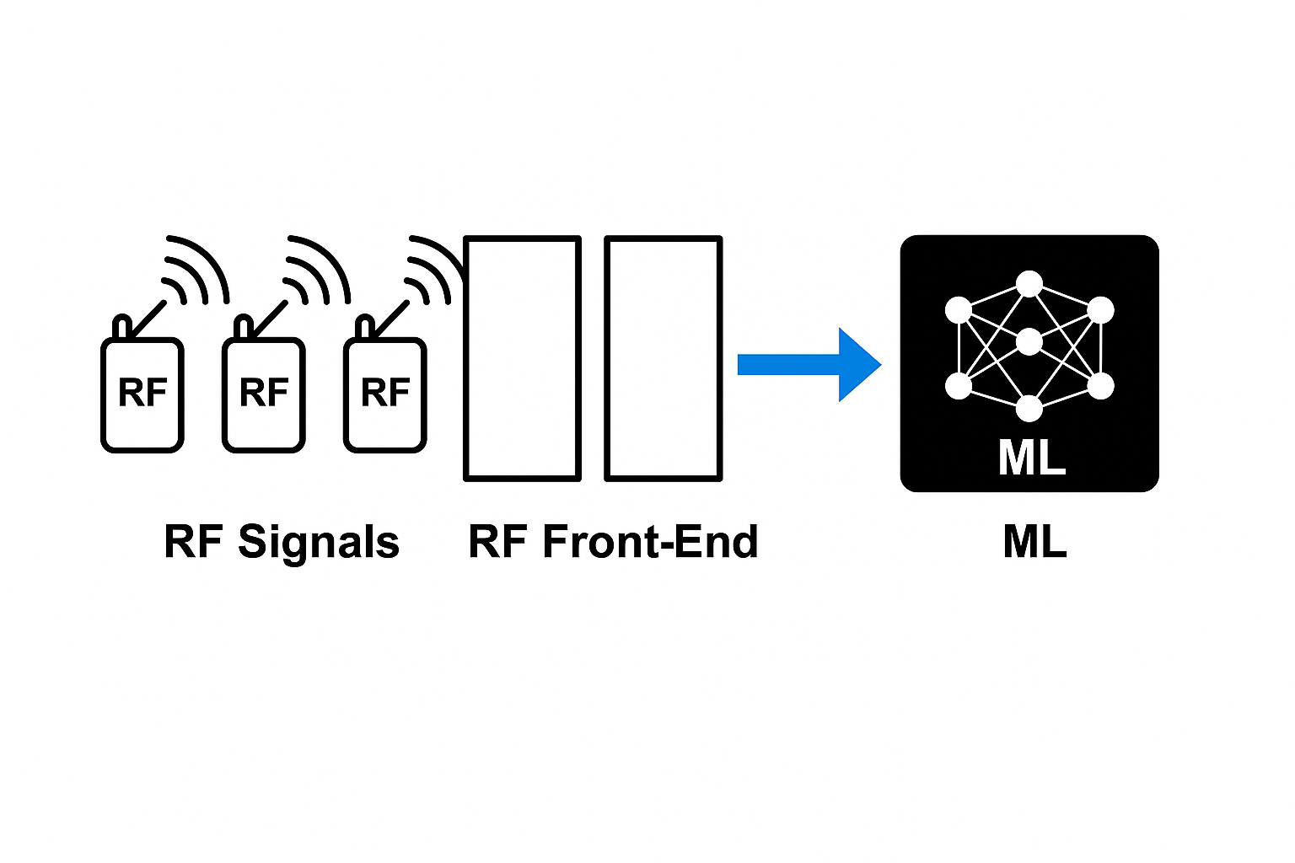
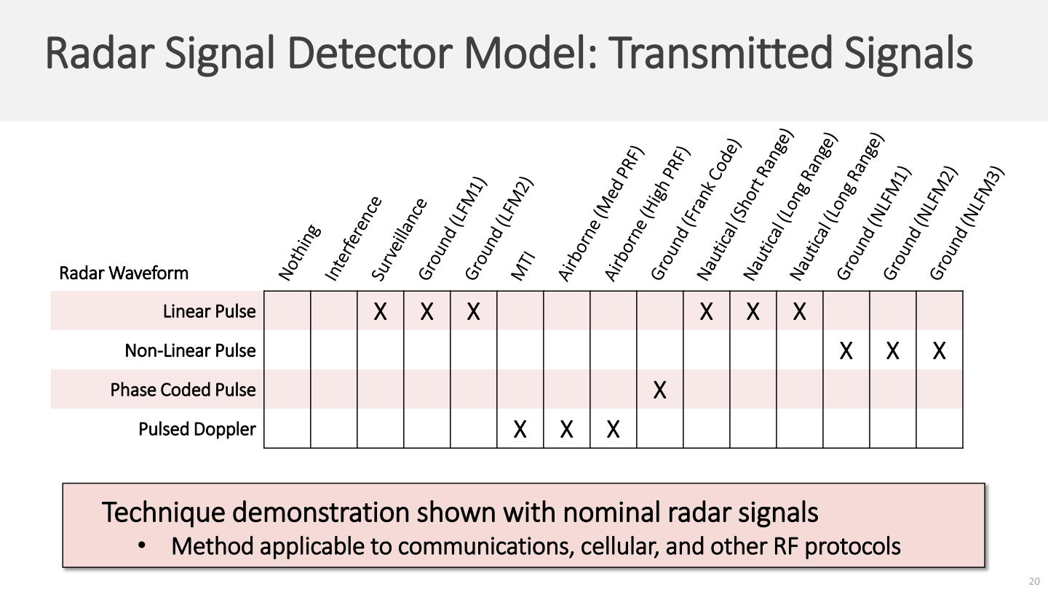
DV : Q&A : Notes
The Node
Listen & Convert : SDR - Digital RF
Turns multi channel radio signals into digital data early on, so software can do the heavy lifting instead of complex hardware GNU Radio
Think & Decide : GPU - ML
Multiple COTS component – Custom build using proven designs and concepts
Software – Intellectual Property
Sovereign pipelines
Approx Cost: Invaluable : Agile development
!
Notes:
Opportunity : Digital RF and Machine Learning & Academic software collaboration
Background on Analog vs Digital RF
Analog Superheterodyne Receiver (top )
Hardware-centric: once built, limited flexibility.
Digital/SDR Receiver (bottom)
Software-controlled (filtering, demodulation, signal analysis).
Highly flexible and reprogrammable
Digital RF turns radio signals into digital data early on, so software can do the heavy lifting instead of complex hardware.
Known to geeks as a SDR, a software defined radio
A high-performance SDR seamlessly integrated with state-of-the-art deep learning hardware
Fit for Purpose : Just enough, just in time
Hardware Proven for Digital ML Radar
ML Agile : Continuous self learning
Proliferation : affordable, scalable, portable, disposable
IP Core : Active and Passive Radar
OODA Loop → Act faster than they can react
How : Multi spectral RF ML sensor fusion
Artificial Intelligence Radio - Transceiver (AIR-T) | Crowd Supply

Slide 26
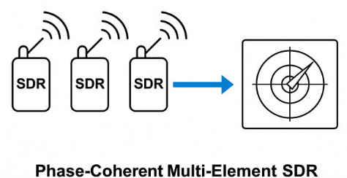
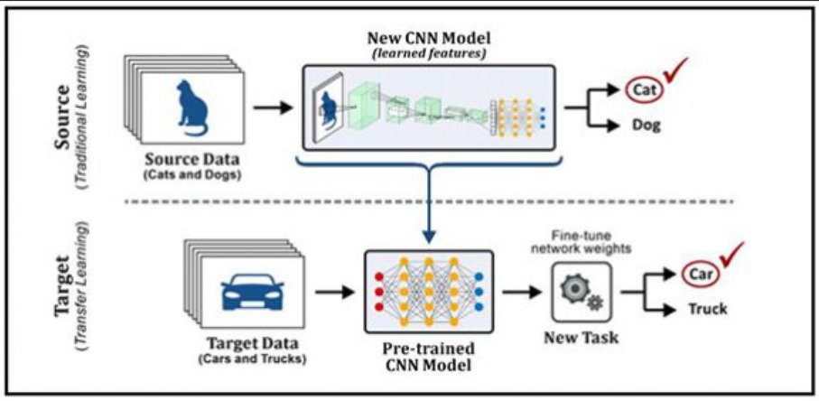

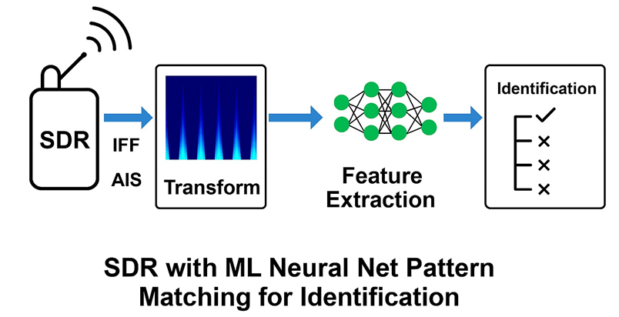
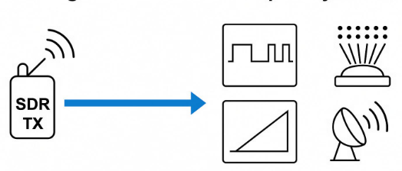
How the Node Works
SDR – Listen & Convert : Digital RF Hardware
Phase‑coherent multi‑element SDR antenna array
for accurate bearing and range estimation
SMR Hardware
ML – Think & Decide : Deep Learning
SDR I/Q data processing with AI/ML
(e.g., CNNs) for classification,
CODEC : Scan & Focus : Active Radar
SDR Transmit Codecs
Pulse, phased array, FMCW, AESA, beam forming
Notes:
How it works : 3 Stages of our development of a Sovereign Digital Radar
This makes it highly flexible, reprogrammable, and ready to meet evolving demands. Traditional analog RF systems were built around fixed hardware, where once assembled, their capabilities were locked in, upgrades required different hardware.
With software and digital RF there is a Collaboration Opportunity between Industry, Defence, and Academia
Software provides the power.
Digital RF doesn’t just simplify design—it amplifies capability. When paired with a high-performance SDR seamlessly integrated with state-of-the-art deep learning hardware and software, it becomes a powerful platform for real-time intelligence, rapid deployment, and mission-ready innovation.
Opportunity
Now is the moment for industry, defence, and academia to come together—transforming into sovereign capability.
Stage 1: Listen & Convert
Radio signals are turned into digital data early.
Software does the work—less need for complex hardware.
Like having many “ears” to locate signals and measure distance.
Known as SDR (Software Defined Radio).
Stage 2: Think & Decide
System uses AI to recognize and classify signals.
Makes fast, smart decisions without human help.
Fully self-contained AI/ML pipeline—no outside input needed.
Stage 3: Scan & Focus
System sends out its own radar signals.
Can aim and shape signals to focus on specific areas.
Uses a software “codec” to create the right signal pattern—this is the IP core.
If tampering is detected, the node auto-wipes itself and alerts the rest of the network.
Hardware is bare-bones—no OS, no storage.
Intellectual Property (software) lives in volatile memory, so it’s instantly erased if power is cut, case is opened, or tampering is sensed.

Slide 27
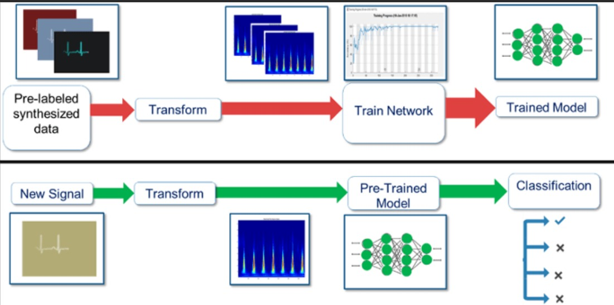

DV : Q&A : Notes
The Node
Listen & Convert : SDR - Digital RF
Turns multi channel radio signals into digital data early on, so software can do the heavy lifting instead of complex hardware
Think & Decide : GPU - ML
Multiple COTS component – Custom build using proven designs and concepts
Software – Intellectual Property
Sovereign pipelines
Invaluable : Agile development
!
Notes:
Opportunity : Digital RF and Machine Learning & Academic software collaboration
Background on Analog vs Digital RF
Analog Superheterodyne Receiver (top )
Hardware-centric: once built, limited flexibility.
Digital/SDR Receiver (bottom)
Software-controlled (filtering, demodulation, signal analysis).
Highly flexible and reprogrammable
Digital RF turns radio signals into digital data early on, so software can do the heavy lifting instead of complex hardware.
Known to geeks as a SDR, a software defined radio
A high-performance SDR seamlessly integrated with state-of-the-art deep learning hardware
Fit for Purpose : Just enough, just in time
Hardware Proven for Digital ML Radar
ML Agile : Continuous self learning
Proliferation : affordable, scalable, portable, disposable
IP Core : Active and Passive Radar
OODA Loop → Act faster than they can react
How : Multi spectral RF ML sensor fusion
Artificial Intelligence Radio - Transceiver (AIR-T) | Crowd Supply

Slide 28
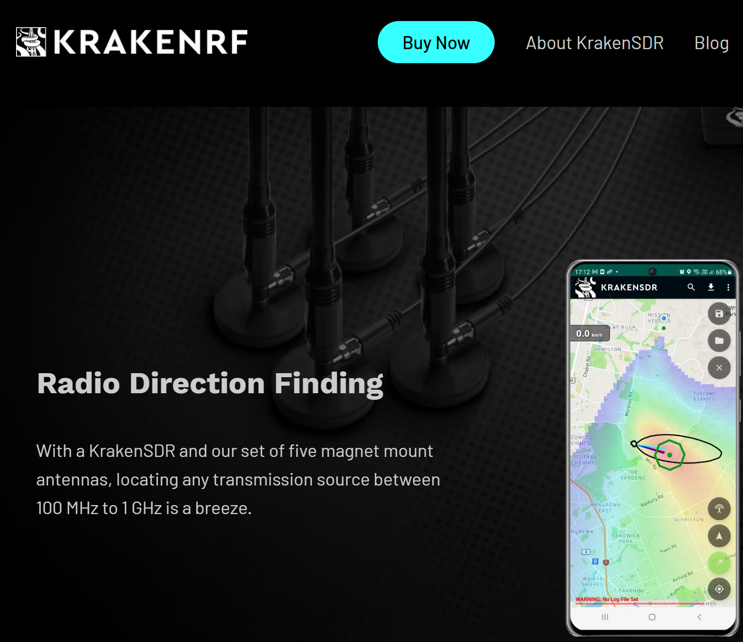
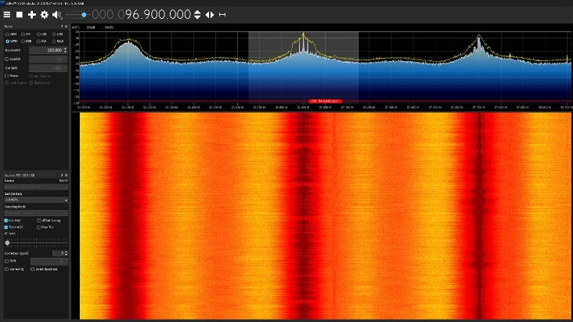
1 – Listen & Convert : Digital RF Hardware
DV : Q&A : Notes
Phase‑coherent multi‑element SDR antenna array for accurate bearing and range estimation
Exiting and proven.
Notes:
Show its been done
DOF Kraken
The origins of SDR trace back to the 1970s and 1980s when the military and defense organizations recognized the need for more flexible and adaptive radio systems. Traditional radios of the time were largely limited to a single frequency or modulation type, making them costly and cumbersome to replace when technology evolved or mission requirements changed.
The journey of Software-Defined Radio from military experiments to a widespread and versatile technology showcases the power of innovation in communication. By enabling the reconfigurability of radios through software, SDR has opened new horizons in research, industry, and even our daily lives. As technology continues to progress, SDR will remain at the forefront of the next generation of wireless communication, empowering us to adapt, innovate, and explore the limits of what’s possible.
One of the earliest innovators in SDR was Joe Mitola, who coined the term “Software-Defined Radio” in 1991. Mitola’s work expanded on earlier military research and helped envision SDR as a technology with far-reaching civilian and commercial applications. He emphasized that by relying on software instead of hardware, radios could adapt to new standards and user requirements in real time, allowing for a more robust and versatile approach to communication

Slide 29

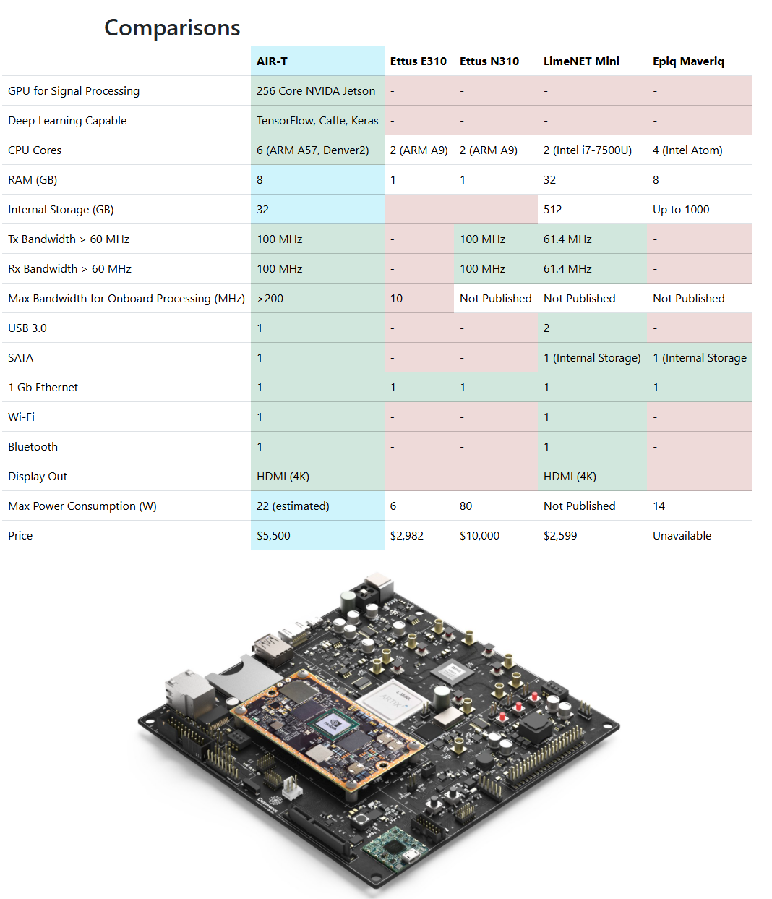
2 – Think & Decide : Deep Learning
DV : Q&A : Notes
SDR I/Q data processing with AI/ML
(e.g., CNNs) for classification,
Notes:
COTS : Artificial Intelligence Radio Transceiver (AIR-T)
The First Radio Frequency System Designed for Deep Learning
LimeSDR
AIR-T Hardware Overview | Deepwave AI

Slide 30
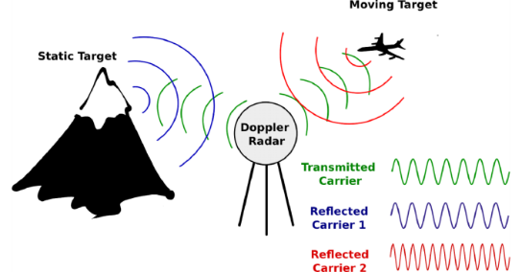
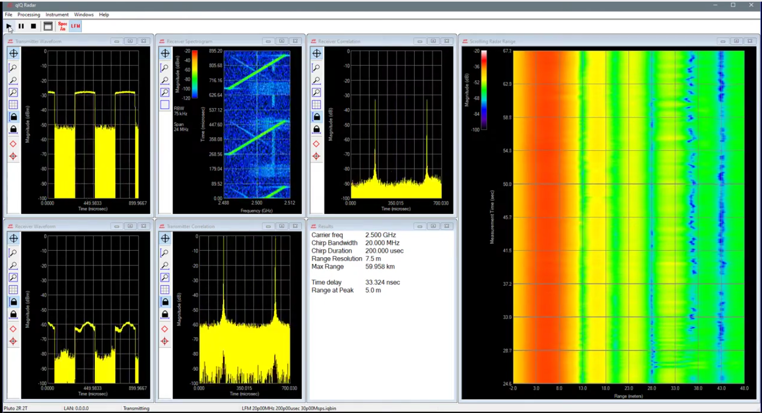
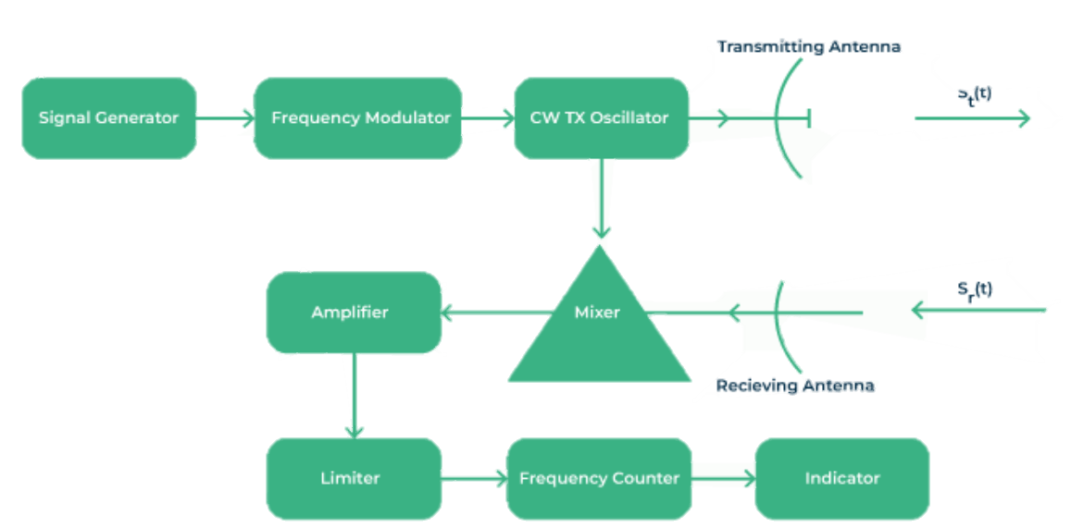
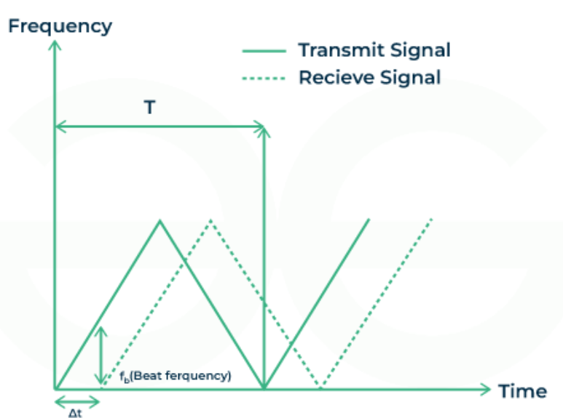
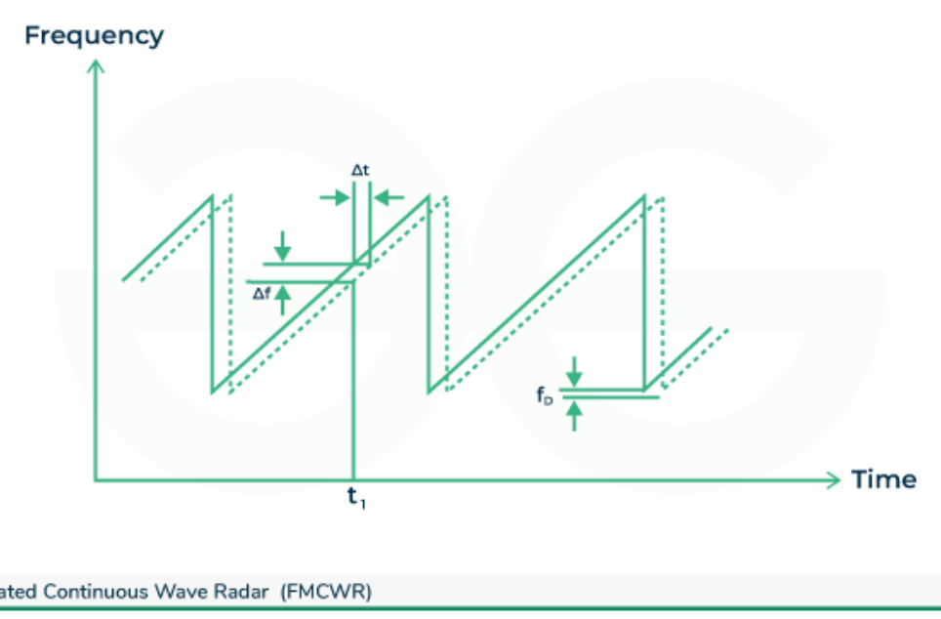
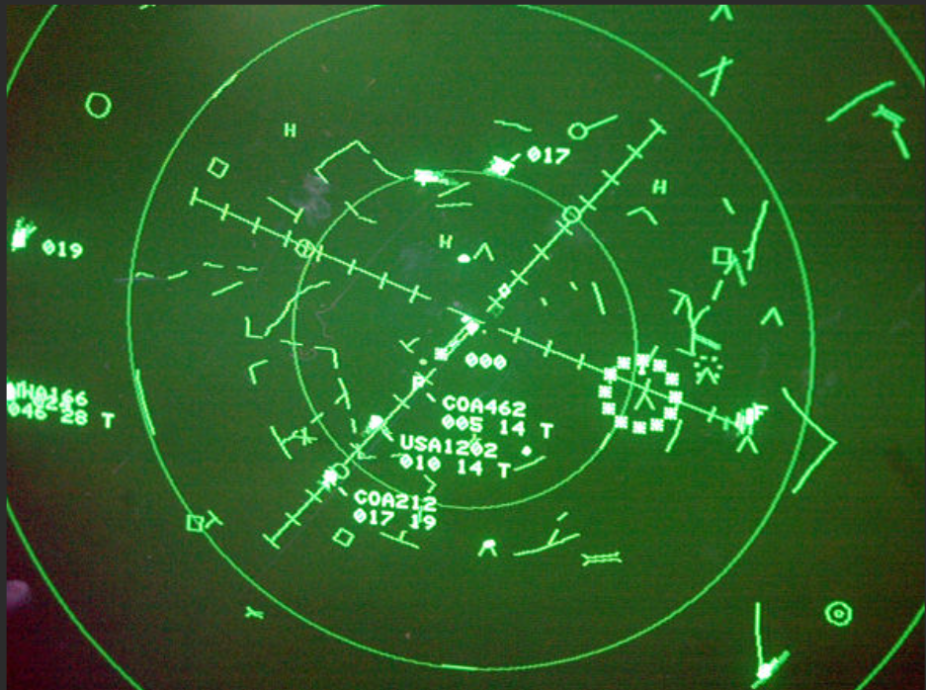
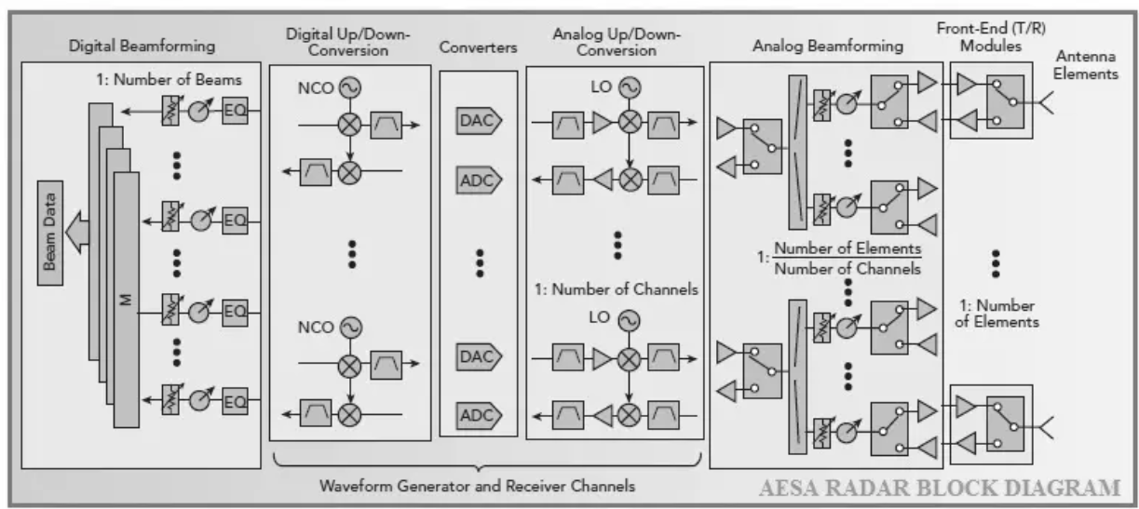
3 : Scan & Focus : Active Radar
Q&A : Notes
SDR Transmit Codecs :
DCMCW
Pulse, phased array, FMCW, AESA, beam forming
Build a Passive Radar With Software-Defined Radio - IEEE Spectrum
TimonPetermann/SDR-Radar
FMCW Radar - GeeksforGeeks
AESA radar (Active Electronically Scanned Array)
Notes:
Radar plot
Digital Code Modulated Continous Wave Radar (DCMCW)
Frequency Modulated Continuous Wave Radar : measuring distance and speed
AESA radar (Active Electronically Scanned Array)
Principle of Operation of FMCWR
Continuous Transmission: FMCW Radar always sends out a signal that changes its frequency slowly over time. People often get this frequency change using a saw-like or triangle shaped pattern.
Transmission and Reflection: The sent signal goes through space until it meets a target. When the signal hits its goal, it bounces back towards the radar system.
Frequency Shift: The signal sent back from the target changes its frequency depending on how far it is and how fast it moves. If the target is moving, changes in sound (beat frequency) between sent and received signals give information about how fast it's going.
Range Measurement: The time it takes for a signal to be sent and received helps us know how far away the target is. The longer you wait, the more distance is between the radar and target.
Low Likelihood of Block (LPI): FMCW radar displays a low likelihood of catch because of its constant and low-power activity

Slide 31
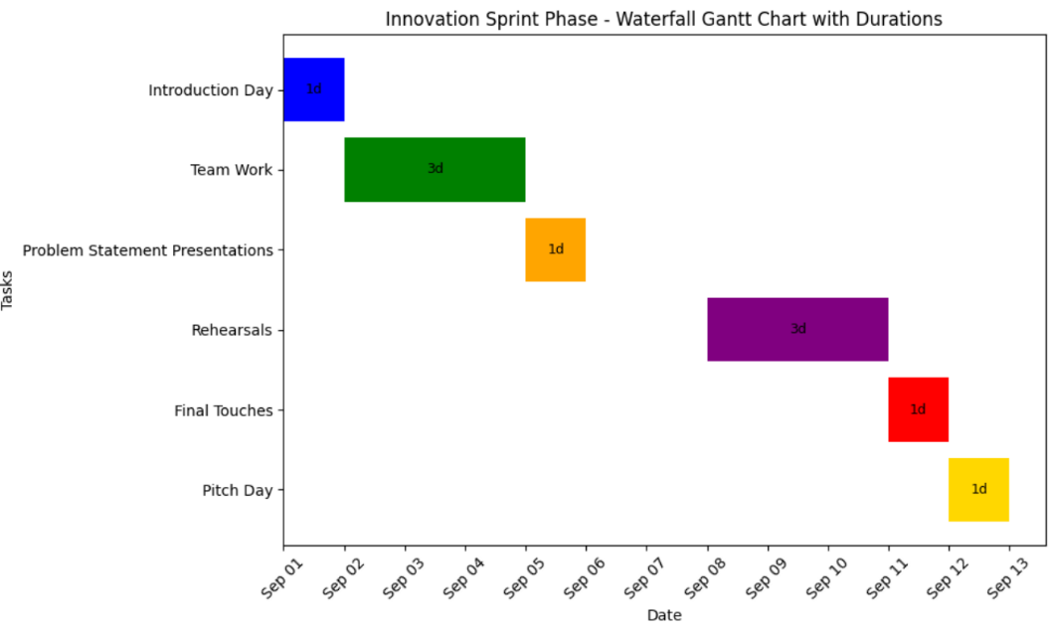
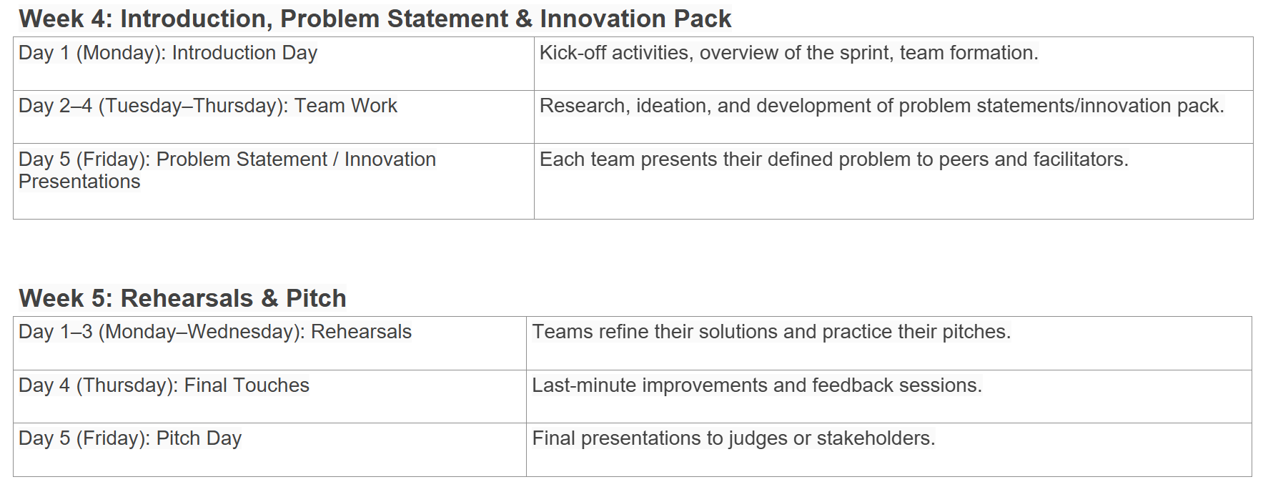
Innovation : Exercise duration

Slide 32
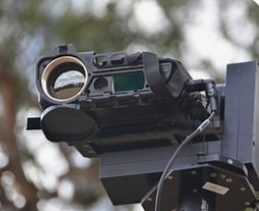
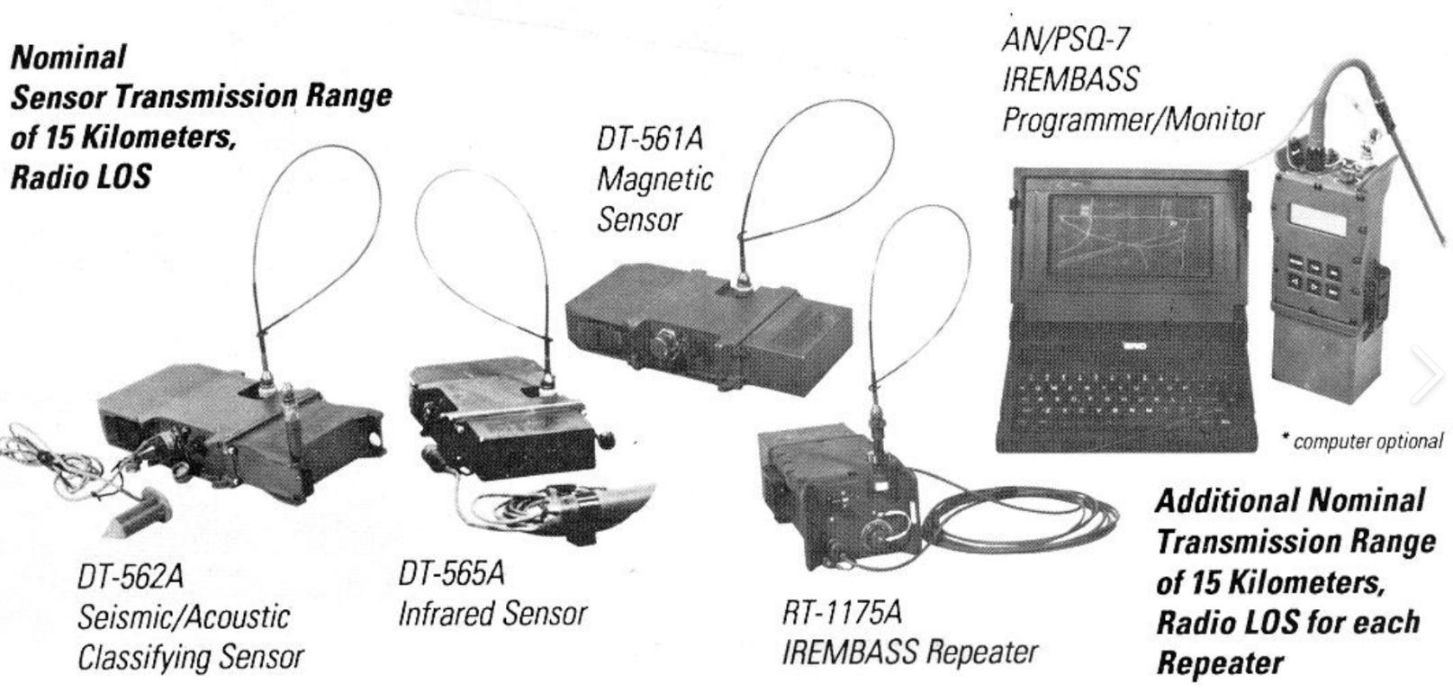
Old PSS Systems
Australian Army’s PPSS (Patrol Persistent Surveillance System) 2014
Rockwell Collins selected by Australian Army to provide “eyes and ears” for soldiers - APDR

Slide 33
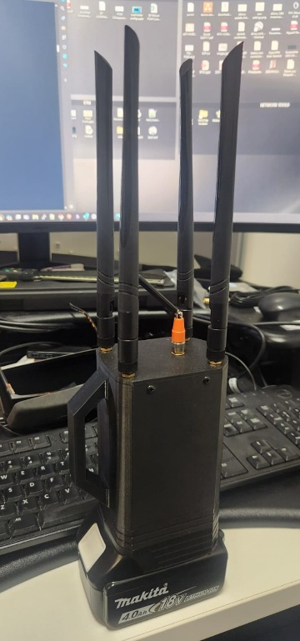
Grant Opportunity
National Intelligence Discovery Grants (NIDG) 🚨
The Australian Research Council (ARC), on behalf of the Office of National Intelligence (ONI), has opened an Expression of Interest for the NIDG program.
💰 Up to $800,000 is available for projects that tackle one of the following priority challenges:
🛰️ Space-based technologies
🕵️ Covert collection
🧬 Emerging biological science
⚛️ Emerging material science
🔐 Cyber, protective & physical security
👥 Identity management
🧠 Human behaviour & influence operations
📊 Data-driven & real-time analysis
🌍 Situational awareness & multi-source assessment
Notes:
📊 Data-driven & real-time analysis
🌍 Situational awareness & multi-source assessment
Offline remote GIS Mapping and threat heat map generation
Electromagnetic and Acoustic Data Collection and Processing
Sensors
Collect and continuously monitor acoustic intelligence data for barrier operations using a low cost, two-person deployed systems for 120 days
Edge processing
Continuously monitor acoustic sensors, automatically detect and classify signals of interest at the edge, and transmit classifications with confidence for barrier operations using a low cost, two-person deployed system for 120 days?
High-performance computing for data processing
Process large volumes of complex acoustic intelligence data ashore to automatically generate data libraries and actionable intelligence

Slide 34
Usage
Preparation
Plan deployment
Issue equipment
Deploy to location
Deployment
Place nodes in location
Secure to power supply
Nodes establish comms
Master node establishes comms higher
Monitor
Nodes report to master node
Master node reports higher
Sam to do
!
Notes:
Preparation
Plan deployment site – number of nodes required, locations, power supply
Equipment issued to the teams who will deploy
Deploy to location
Deployment
Place nodes in location
Secure to power supply – mains, batteries, solar
Nodes establish comms with each other
Master node establishes comms higher using existing systems
Monitor
Nodes report to master node: on event, on command, on interval
Master node reports higher: on event, on command, on interval

Slide 35
Solution Roadmap
Sam to do
Hardware
SDR Hardware Integration
Ruggedisation
RF/ML Processing
RF Processing
ML Training
ADF Integration
Operator Interfacing
ADF Integration
Size, Weight & Power
3 x Tech Dev Streams
!
Notes:
Realising SMR requires collaboration between academia, industry and the ADF.
- Industry partners are likely best suited to developing the hardware,
- Academic partners with industry to develop the SDR and ML software and
- Defence to drive integration to meet operator needs.
SMR has multiple technology paths that need maturing.
There are three, largely independent development streams,
Hardware : Node hardware development (Blue),
Software : RF processing and ML training(Green) and
Integration : Most importantly ADF and operator integration (Purple) to enable decision making.
There is the opportunity to incrementally develop each of these streams independently,
- Industry partners are likely best suited to developing the hardware,
- Academic partners with industry to develop the SDR and ML software and
- Defence to drive integration to meet operator needs.

Slide 36
Solution Roadmap
Sam to do
All major components are off-the-shelf
Can be developed by many Perth based SME as well as IXG internal capabilities, with industry support.
!
Notes:
Realizing SMR has multiple technology paths that need maturing.
There are three, largely independent development streams, node hardware development (BROWN), RF processing and ML training and most importantly ADF and operator integration to enable decision making.
There is the opportunity here to incrementally develop each of these streams independently, industry partners are likely best suited to developing the hardware, academic partners to develop the SDR and ML software and Defence to drive integration to meet operator needs.
University collaboration – Software algo
Soverign development
Chevron :Delivery stages
EXAMPLE SCRIPT FROM LAST YEAR: To realize this Capability Project Neptune has to develop the following critical technology elements and integrate it into an operational environment.
Vibrations in the ocean are received by the DAS interrogator, Acoustic Propagation Modelling negates the distortion of water as the medium, a signal of interest needs to be identified, classified and determine to be a threat before being transmitted to existing defence infrastructure for integration into a battle management systems and enabling decision making.
Each CTE is possible and used in some prior application, tying them together and interfacing into defence is the key to capability.
We've colored each CTE block based on who we anticipate to be the most appropriate sector to perform the development.

Slide 37
Solution
Sam's version of slide above
SMR : SDR ML RADAR
Soldier-Portable Software Defined Radio (SDR)
Designed to be left in situ
Low-cost / Low-class alternative to traditional RADAR infrastructure
Real-time RF monitoring
Detects changes in the radio frequency (RF) environment - Walk
Acts as passive radar - Crawl
Acts as active radar - Run
Mesh communicating
Each node can be independently and dynamically reconfigured based on operational needs
!

Slide 38
Future & Advanced Features
Active Radar
Signal Intradiction
Jamming
Spoofing
Radio Supplementation
Ross to do DONE, room for expansion
!
Notes:
Thinking BlueSky, there are many potentials for this technology to extend to.
Additional sensors such as acoustics or optics can be added variables into the machine learning assessment as to whether the local environment is changing.
Rapid cooperative and coordinated retuning of multiple nodes could refine data collection similar to focusing an optical lens
With SDRs being an unclassified common radio enthusiast tool and the core technology component to the nodes, civilian SDRs could be unified and repurposed to enable sovereign defence strategies.
MOVE SOMEWHER ELSE IN PRESO
SDRs as the core technology component are now a relatively cheap commercial item with vast existing stock and diverse supply chains, allowing for resilient acquisition in a time of need

Slide 39
Features
Sam to do
Feature 1
benefit
Feature 2
benefit
Feature 3
benefit
!

Slide 40
Usage
Ground Node Physical Description
What critical components, in what arrangement form a node?
Nodes are ruggedised
Contain:
SDR and antennas
Battery System
Inertial Measurement Unit
Sam to do
!
Notes:
Each node contains:
SDR with amplifier and antennas
Battery System to power the node
Inertial Measurement Sensor to detect if the node is moved
All contained within a ruggedized housing.
Each node is supported by a solar panel and at least one node in the mesh needs a digital data link to the command and control infrastructure.

Slide 41
Scenario Example
Critical Substation between towns in NW Australia
Diaspora Elements have inserted
Likely to attack via UAV
SDRs detect UAV's being set up prior to launch
QRF may be deployed and contingency power mobilised.
Scenario to infographiced
!
Notes:
Consider this Scenario: SMR : Software Defined Machine Learning RADAR is a Remote Infrastructure Defense
A remote substation powers critical assets across the grid.
Six PROJECT Ys nodes form a 1-kilometer perimeter around it.
Three nodes passively monitor radio frequencies—learning what “normal” looks like and spotting anomalies.
Three others use internode pings as radar, detecting airborne objects.
Each node is solar-powered, rugged, and reports back for months without maintenance.
Before a major strategic event, hostile UAVs approach—armed with explosives.
The system detects them kilometers out and identifies the threat.
Instantly, three nodes jam GPS signals.
The other three block the UAVs’ command-and-control links.
With navigation and communications disabled, the UAVs fail.
The substation stays online. The mission is protected.

Slide 42
Potential Features
Node Tamper Resistance
Sam to do
!
Notes:
Mesh network is redundant and distributed, so it stays strong even if one part is attacked.
Each node uses GNSS signals + motion sensors + nearby signals to detect tampering.

Slide 43
Uses Cases
Sam to summarise followimgslides
Overview slide with 3 scenarios outlining use cases
!

Slide 44
Capability Concept
SMR Concept
A Deployable Passive & Active RADAR Using Digital RF & Machine Learning
End User
Brigade asset
Deployment
Affordable, scalable, portable, disposable
Situational Awareness
Real-time with map overlays
Integration
ADF C2 systems and GIS platforms
Notes:
Our proposal is SMR, a SDR Machine Learning RADAR, deployed in remote regions as a mesh network of distributed sensor nodes with intelligent edge processing.
SMR provides a low friction alternative to traditional RADAR infrastructure, capturing changes in the RF environment passively or actively in real-time.
Supported by remotely located C2 infrastructure, each SMR node can be independently dynamically reconfigured based on operational needs.
Capability concept
Low detect, secure ISR border surveillance kit combining low-power passive RF sensors with multi-domain feeds (acoustic, seismic, optical), relayed via encrypted burst-data transmission.
Moonshot
Innovation: Field-deployable “black box” ISR nodes that stay invisible in spectrum monitoring while still providing continuous situational feeds.
Innovation: Resilient ISR mesh that self-organises and re-tasks when individual assets are lost or jammed.
Innovation: Zero-delay software sustainment — upgrade, or customise capability in-theatre without relying on resupply convoys.

Slide 45
Problem
Current defense RF detection methods involve high classification, high-cost and high-inertia assets. These assets are targetable and exceedingly difficult to replace in a time of crisis. This slows the ability for commanders to make decision about their usage which in turn slows the ability for downstream decisions to be made. This is not viable in modern extremely rapid environments.
How can significant reductions in costs and increases in edge computing capability allow for the development of a tool which can increase the pace of the deployment of these asset in a manner which is low risk and resilient to disruption.
Critical infrastructure in remote areas are vulnerable to low-cost, multi-domain threats. Current detection systems are generally expensive and not easily or quickly relocated to these remote locations. Supply chains, particularly those that rely on international sources, can be easily interrupted. Large volumes of data generated from multi-spectral sensors can obscure useful intelligence without efficient processing at the point of collection.
How can an Australian team deliver a scalable, flexible, rapidly deployable solution to providing persistent situational awareness of areas in close proximity to remote critical infrastructure?
!

Slide 46
Solution Roadmap
Sam to do
Stages
Stage 1 – Year 1
Prototype/ Light field trials
$10,000
Stage 2 – Year 2
Extensive Field Trials and ML testing
$50,000
Stage 3 - Year 3
Advanced Prototype
$500,000
Structure
Establish Civilian / Defence working group
IP owned by Defence
Exclusive to sovereign Australian entities
Design and prototyping to be completed by civilian entities
Open shared utilisation defence locations and facilities
Testing to be completed by defence
!
Notes:
Realizing SMR has multiple technology paths that need maturing.
There are three, largely independent development streams, node hardware development (BROWN), RF processing and ML training and most importantly ADF and operator integration to enable decision making.
There is the opportunity here to incrementally develop each of these streams independently, industry partners are likely best suited to developing the hardware, academic partners to develop the SDR and ML software and Defence to drive integration to meet operator needs.
University collaboration – Software algo
Soverign development
Chevron :Delivery stages
EXAMPLE SCRIPT FROM LAST YEAR: To realize this Capability Project Neptune has to develop the following critical technology elements and integrate it into an operational environment.
Vibrations in the ocean are received by the DAS interrogator, Acoustic Propagation Modelling negates the distortion of water as the medium, a signal of interest needs to be identified, classified and determine to be a threat before being transmitted to existing defence infrastructure for integration into a battle management systems and enabling decision making.
Each CTE is possible and used in some prior application, tying them together and interfacing into defence is the key to capability.
We've colored each CTE block based on who we anticipate to be the most appropriate sector to perform the development.

Slide 47
Use Case
An ADF patrol along the Pilbara coast deploys a sovereign AI/ML-enabled payload. The system includes a Software Defined Radio (SDR) antenna array capable of direction finding (bearing and range estimation) and EMI classification. SDR outputs are fused locally with other sensor data via resilient edge communications. Operators receive a real-time GIS alert, providing actionable situational awareness without reliance on overseas ISR(Intellingence, Surveillance, Reconnaissance) feeds.
To be condensed into previous slide
!

